Slide 1
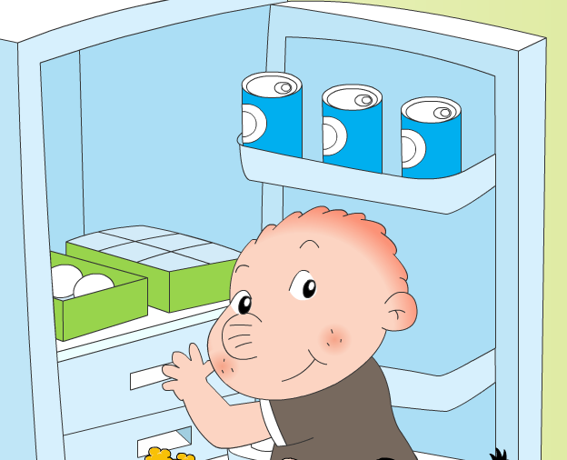
Module 3 Unit 2
Will we have breakfast at 7?

Slide 2

Breakfast
What?
When?

Slide 3
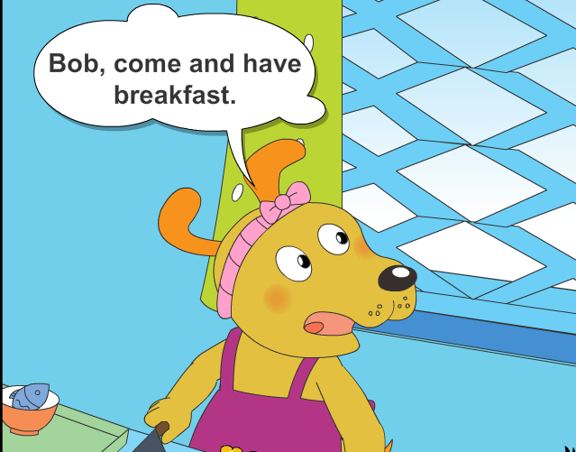
Who will eat the breakfast if Bob’s late?

Slide 4
Who had the breakfast?
What will Bob do next time?

Slide 5
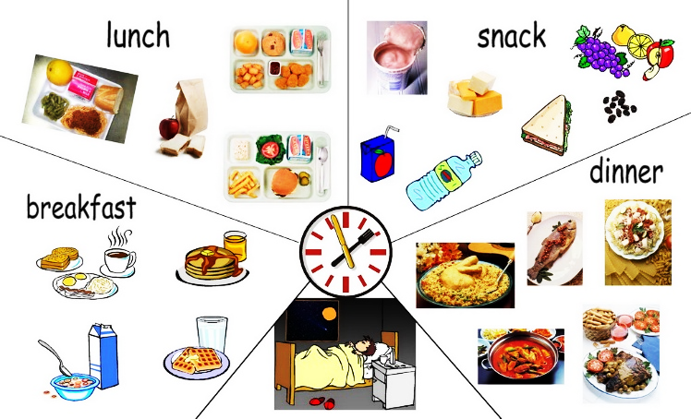

Sam is wondering about the meal time today.
?

Slide 6
Look, listen and tick ( √ ):
They’ll have ______ today.
( )1. breakfast
( ) 2. lunch
( ) 3. tea party
( ) 4. dinner
√
√
√
√

Slide 7
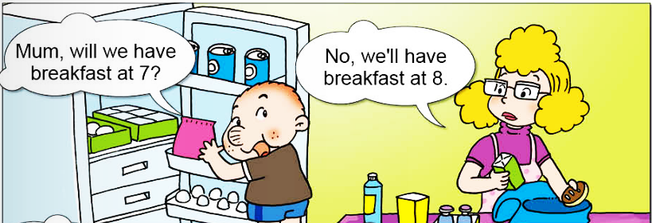


Slide 8
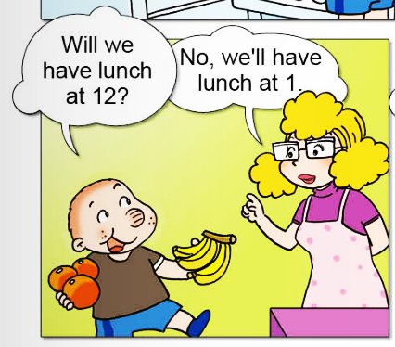

Slide 9
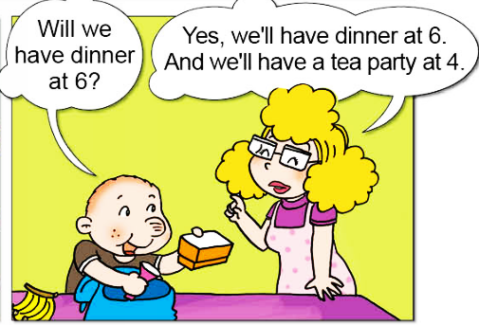

Slide 10
Look, listen and read:

Slide 11
Review and tick ( √ ):
Meals | Time
Breakfast | ( )7:00 ( )8:00
Lunch | ( )12:00 ( )13:00
( )Dinner ( )Tea party | 4:00
( )Dinner ( )Tea party | 6:00
√
√
√
√

Slide 12

Role-play
Will we have breakfast at 7?
Yes, we will. No, we won’t.

Slide 13
You’re going to the park today.
What will you see?

Slide 14
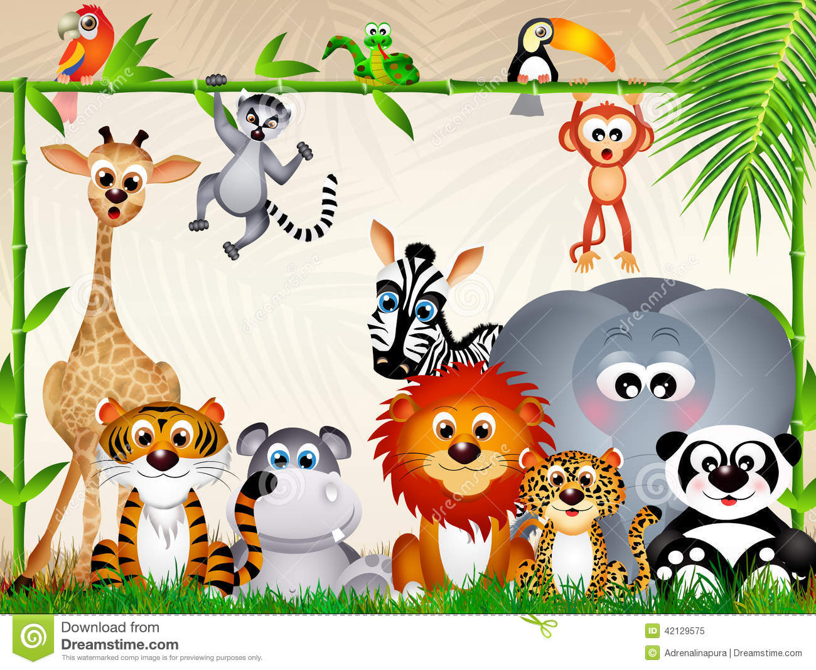
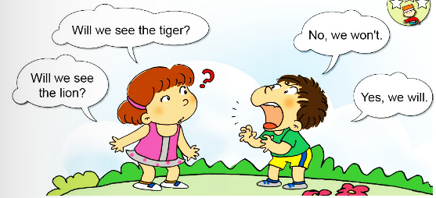
We’re going to the zoo today.
What will we see?

Slide 15
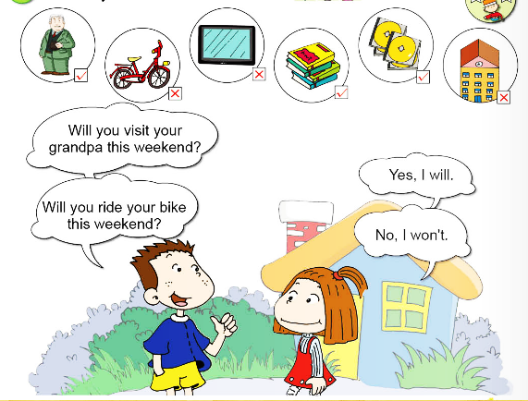

Slide 16
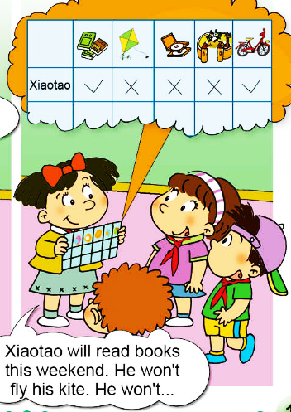

Slide 17
Do you know?
Will we have lunch at 8?
Will we see tigers?
Will you read book this weekend?
Yes, you/we will.
No, you/we won’t.

Slide 18
Can you try?
you, Will, to, go, the, zoo (?)
_________________________________
2. Will, see, lions, we (?)
_________________________________
回答：Yes, ______________.
Will you go to the zoo?
Will we see lions?
we will

