Slide 1
Module 5 Unit 1 Will you take your ball tomorrow?

Slide 2
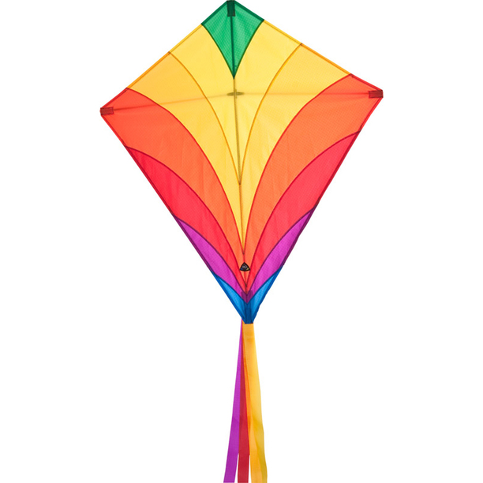
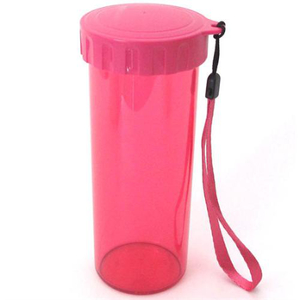
We're going to have our spring outgoing.
Will you take...?
kite
ball
bottle
umbrella

Slide 3
Is Kitty going to Hong Kong this Sunday?
Why not?

Slide 4
Will they take…?

Slide 5
Will Amy take her kite and ball tomorrow?
Why not?

Slide 6
?
?

Slide 7
?
?

Slide 8
?
?

Slide 9
?

Slide 10
?

Slide 11
Listen and repeat!

Slide 12
Role-play
Will you take your ______?
No, I won't.
/Yes, I will.

Slide 13
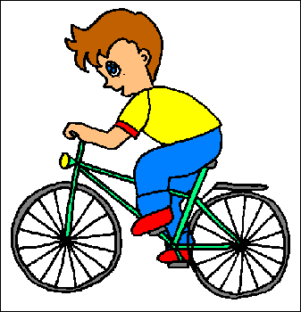
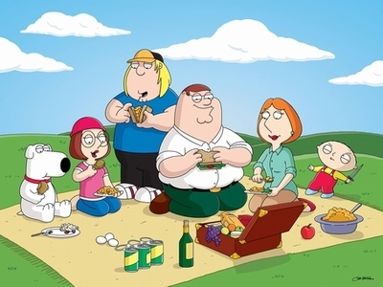
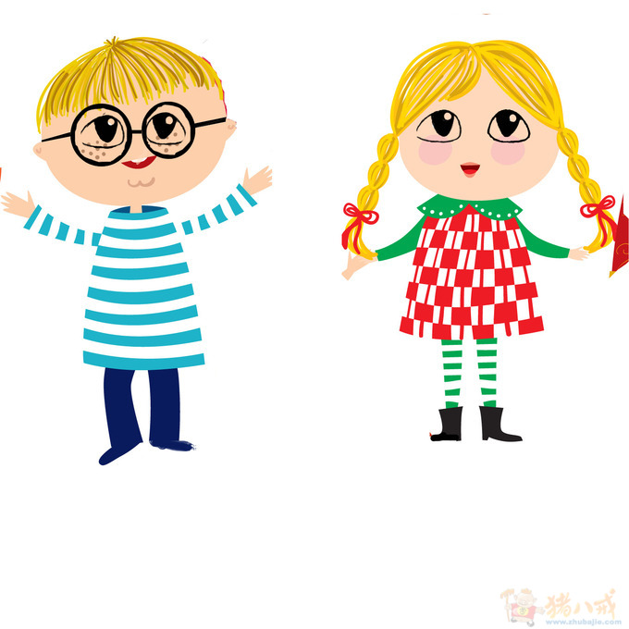
My Spring outgoing plan.
Will you take your ______?
No, I won't.
/Yes, I will.
Will you ______?

