Slide 1
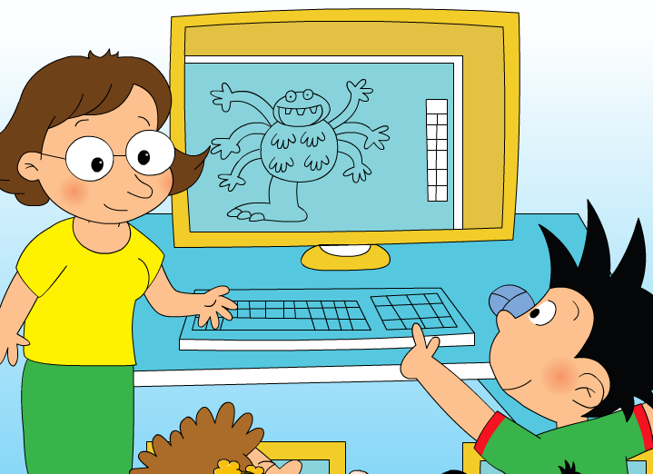
Module 6 Unit 1
Here are his hands.

Slide 2
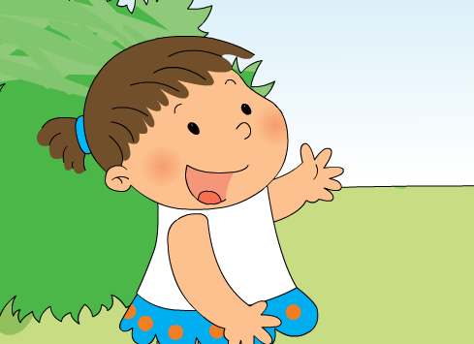
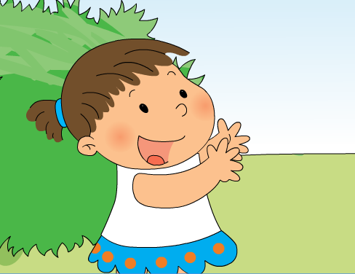
one hand
two hands

Slide 3
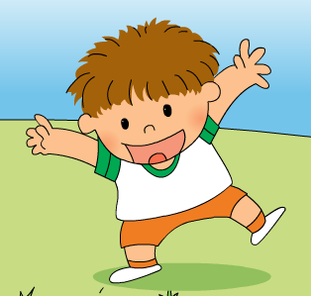
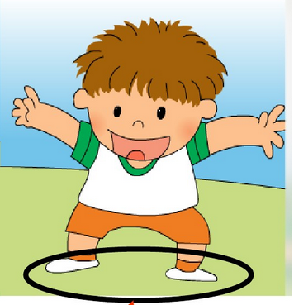
one foot
two feet

Slide 4

Listen and chant:

Slide 5
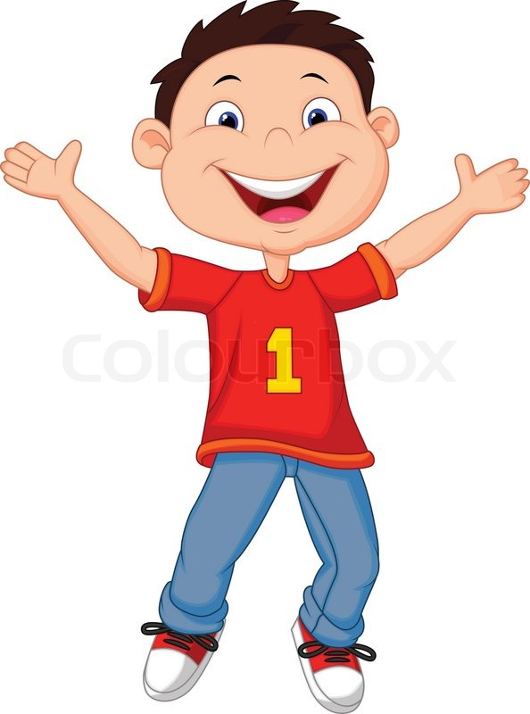
s
one
head
two
eye
s
two
ear
ten
finger
s
one
mouth
hand
two
s
arm
two
s
two
s
leg
two
foot
feet

Slide 6
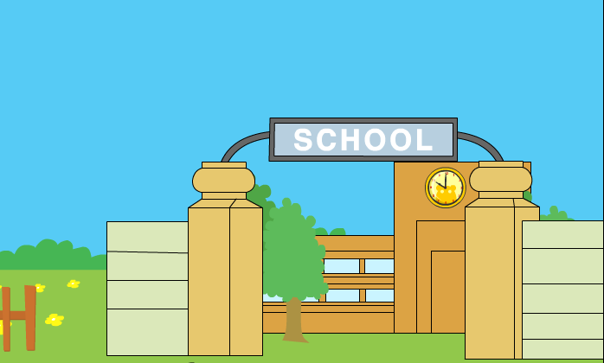

Slide 7
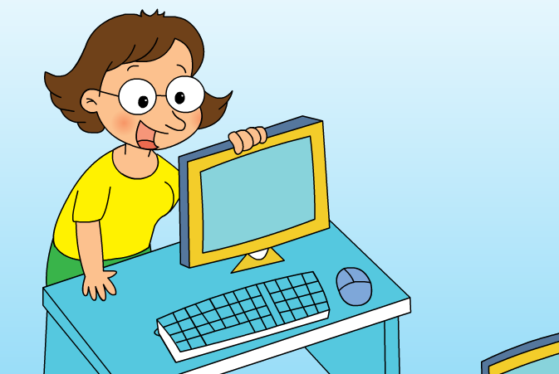
computer

Slide 8
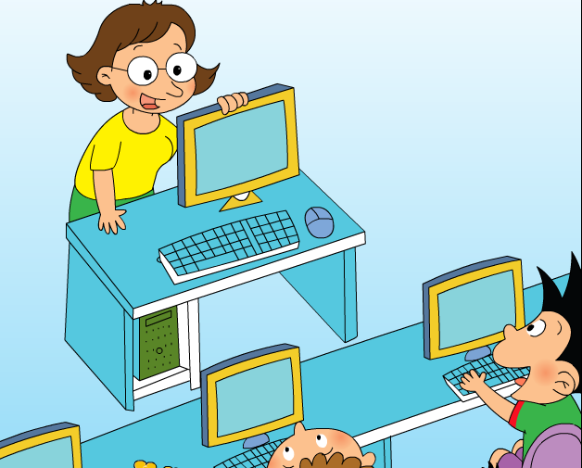
What are they going to do?

Slide 9

What are they going to do?

Slide 10
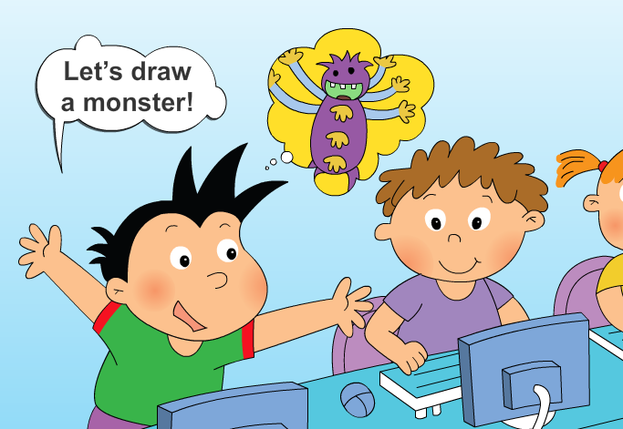


Slide 11
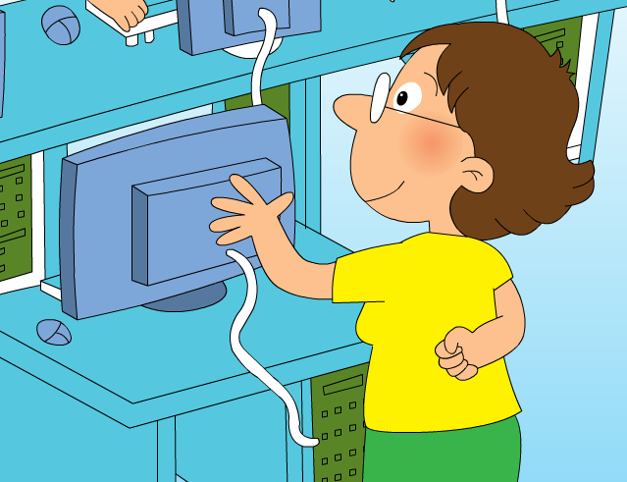
Good idea! Let’s draw a monster on the computer. Now watch…

Slide 12
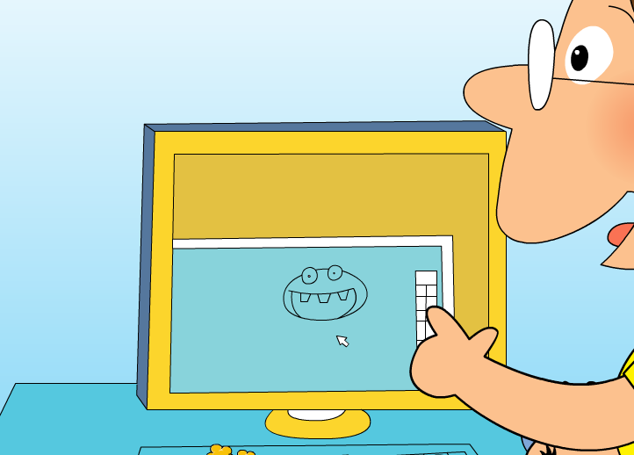
Here_____his head.
is

Slide 13
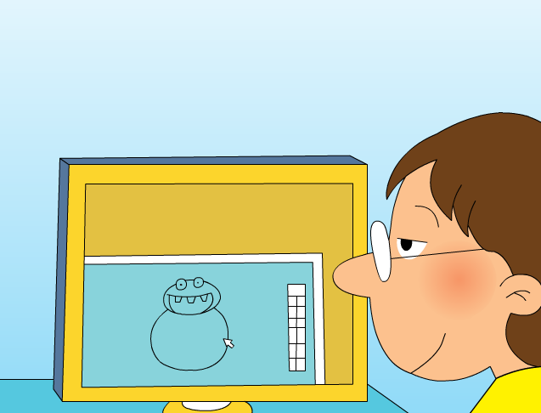
And here ___ his body.
is

Slide 14
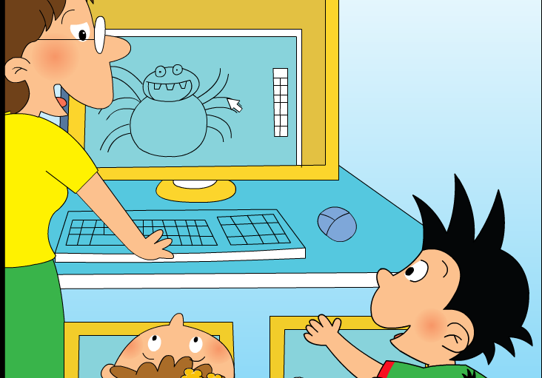
Here ___ his arms.
are
How many arms?
_____ arms!
_____ arms!
six
six

Slide 15
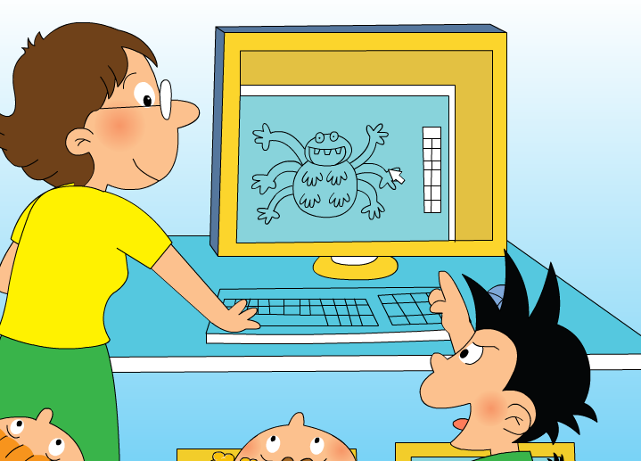


Here ___ his hands.
are
How many hands?
ten
_____ hands!
_____ hands!
ten

Slide 16


are
Here ____ his leg and his foot.
How many legs and feet?
one
_____ leg!
_____ foot!
one

Slide 17
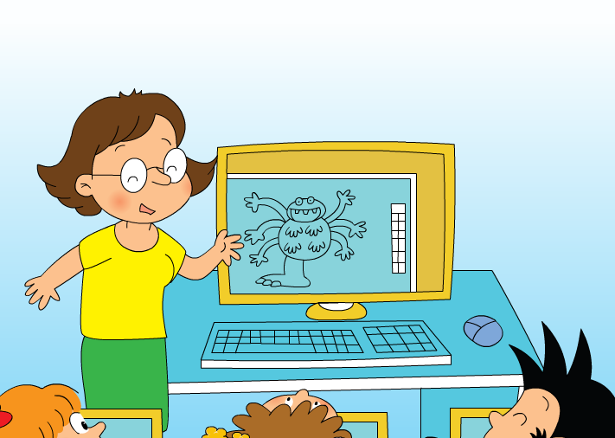
All right. Let’s have a look. The monster has got_________________________________.
one head, ten hands, six arms, one leg, one foot and one body.
Ha ha…

Slide 18
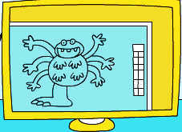
Here is his…
Here are his…
The monster has got…

Slide 19
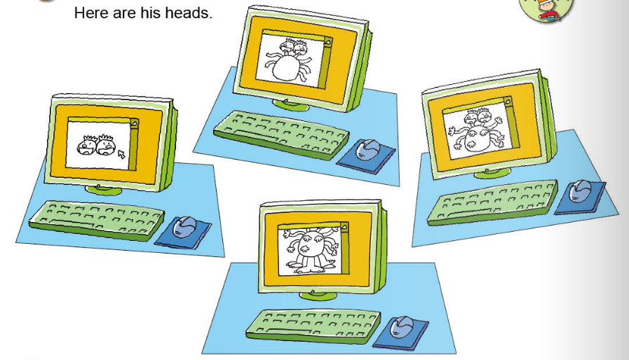
Here is his…
Here are his…
The monster has got…

Slide 20

Draw a monster. Then introduce it!
This is my monster.
Here is his…
Here are his…
The monster has got…

