Slide 1
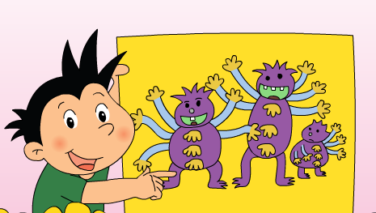
Module 6 Unit 2
There is a small monster.

Slide 2
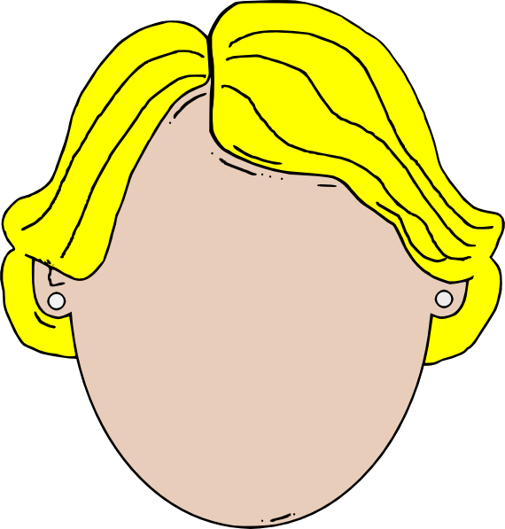
What are there on your face?
?

Slide 3
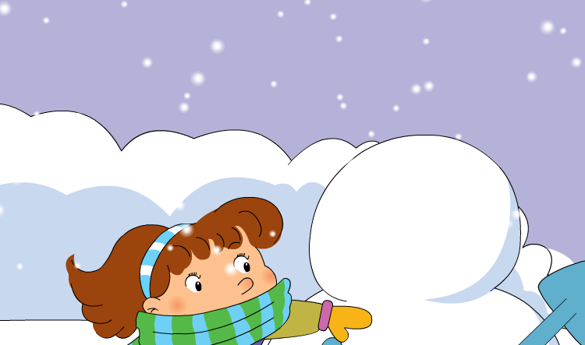
What are there on the snowman’s face?
?

Slide 4
What are there on the snowman’s face?

Slide 5
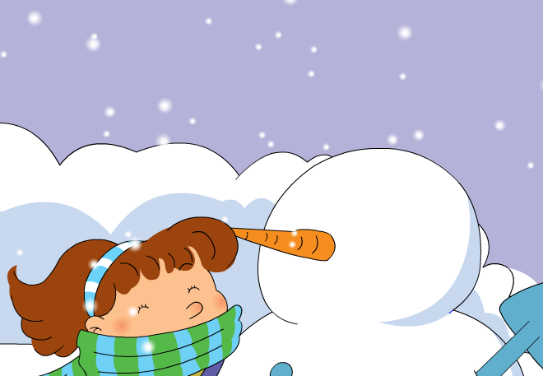
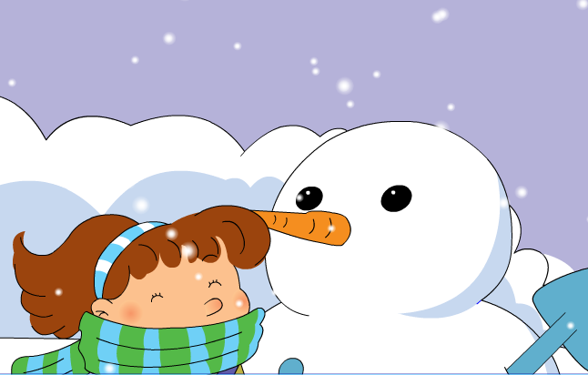
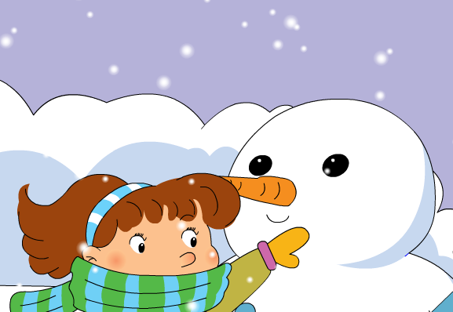
What are there on the snowman’s face?
There is a nose on your face.
There are two eyes on your face.
There is a mouth on your face.

Slide 6
What are there on the monsters’ body?
This is our poster.

Slide 7

is
There ___ a small monster.
are
There ___ two big monsters.

Slide 8
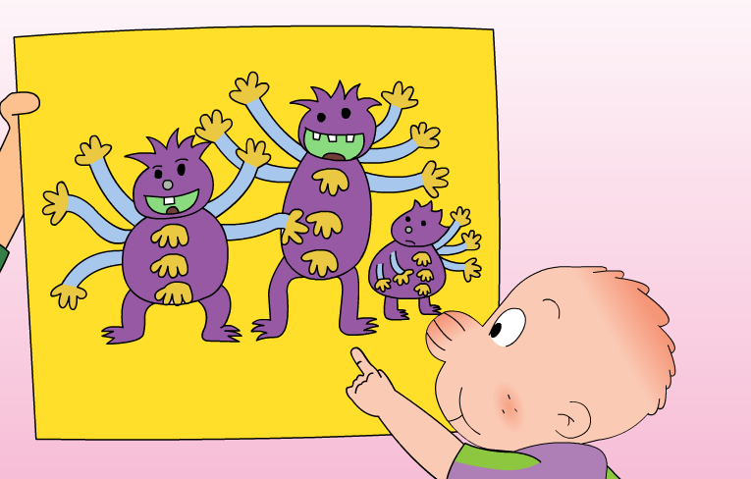
are
There ___ twenty-four hands.

Slide 9
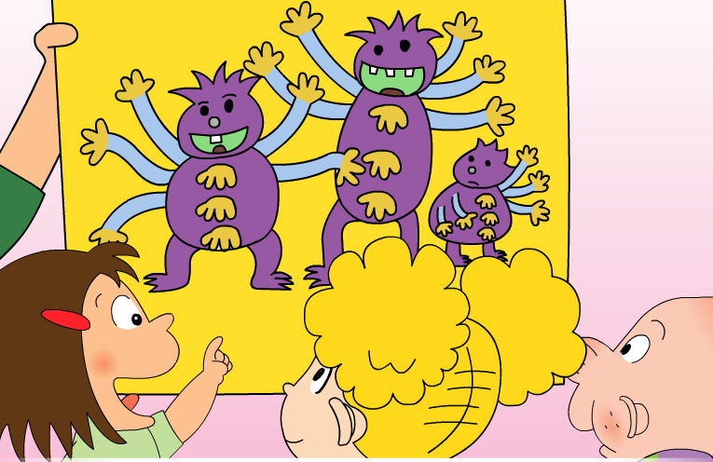
There ___ fifteen arms.
are

Slide 10
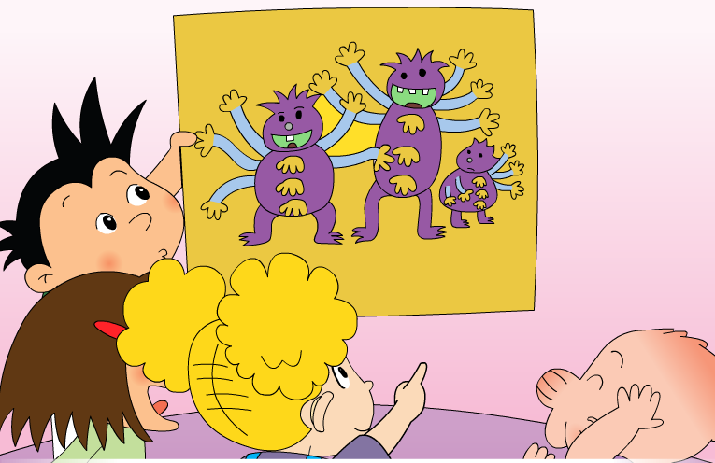
are
There ___ six legs and six feet.

Slide 11
Listen and read

Slide 12
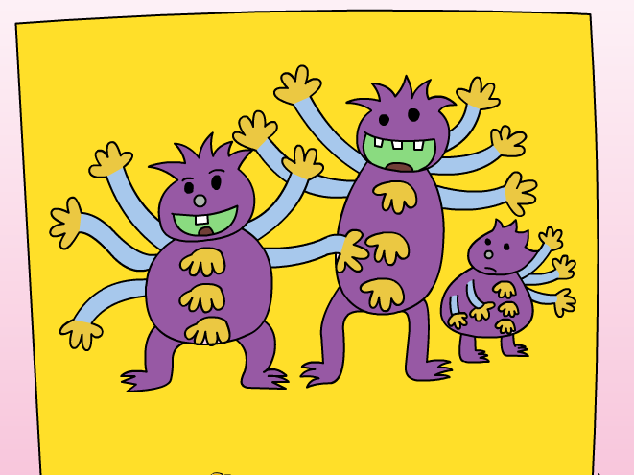
Look and choose!
There ____(is/are) a small monster.
There ____(is/are) two big monsters.
There ____(is/are) twenty-four hands.
There ____(is/are) fifteen arms.
There ____(is/are) six legs and six feet.
is
are
are
are
are

Slide 13
Now, you introduce the monsters!
There is …
There are…

Slide 14
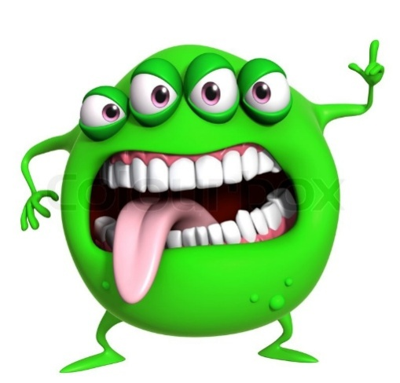
You Introduce your posters!
This is our monster.
There is…
There are…

Slide 15
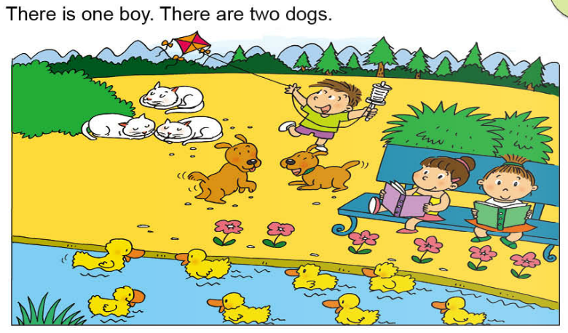
What are there in the picture?

Slide 16
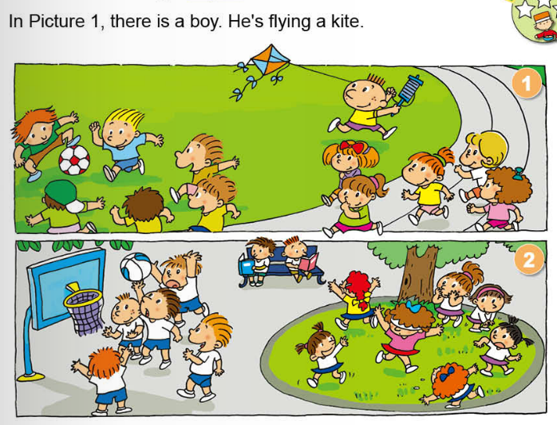
PK

Slide 17
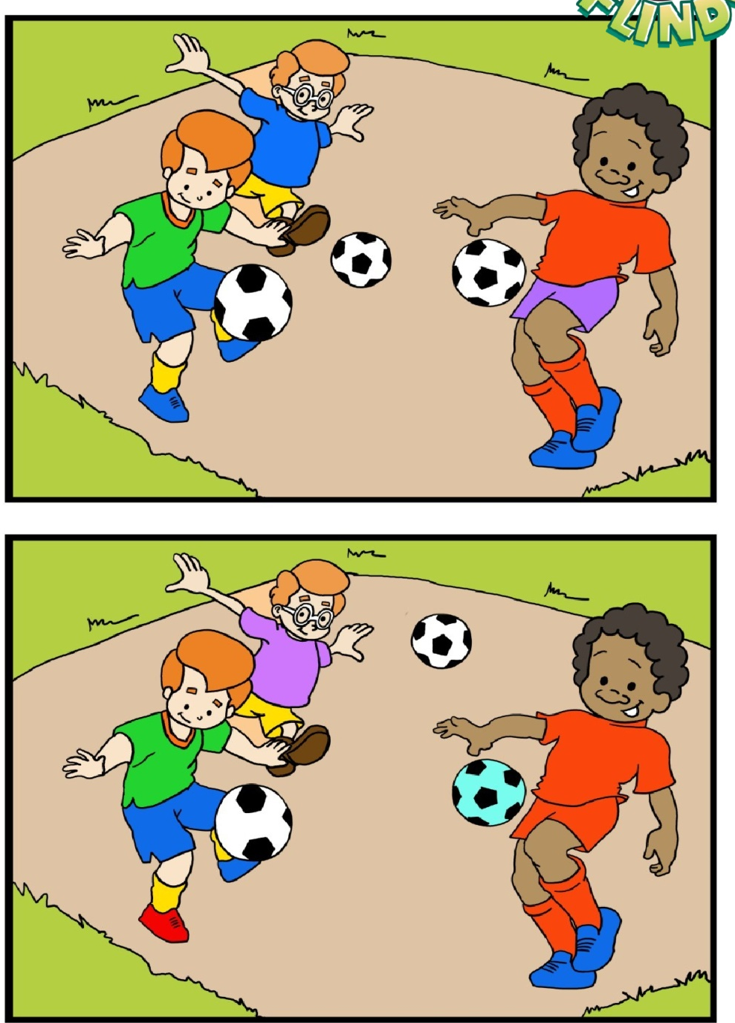
In picture 1, there is a boy.
He is wearing blue T-shirt.
1
2

Slide 18
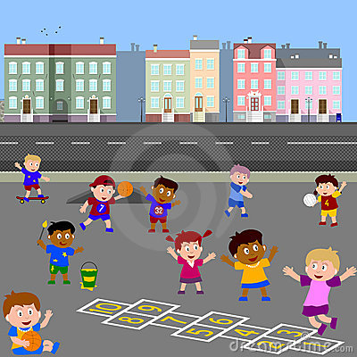
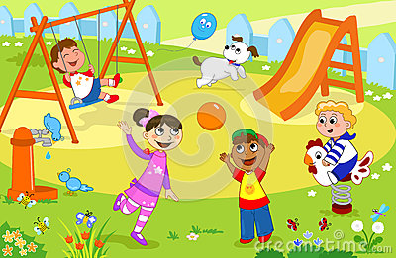
In picture 1, there is one boy. He is painting.

Slide 19
Three Green Parrots

Slide 20
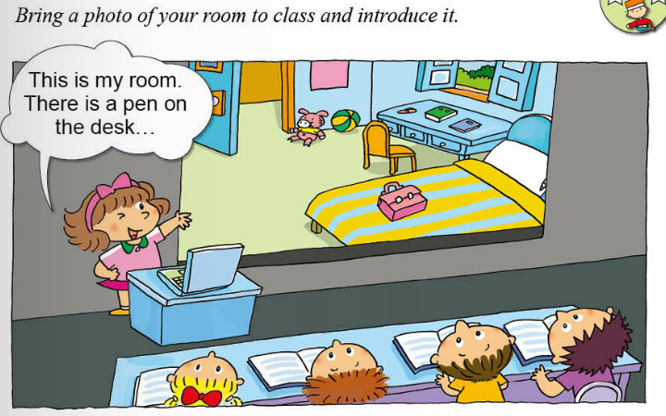
Homework

