Slide 1


Frog jumping

Slide 2
fat
short
long
tall
thin
old
young
young
thin
fat

Slide 3



Chant ：
Tall tall tall. I am tall.
Short short short. You are short.
Fat fat fat. He is fat.
Thin thin thin. She is thin.
Naughty naughty naughty.It is naughty.
Old old old. They are old.
Young young young. We are young.

Slide 4
What are they talking about?

Slide 5
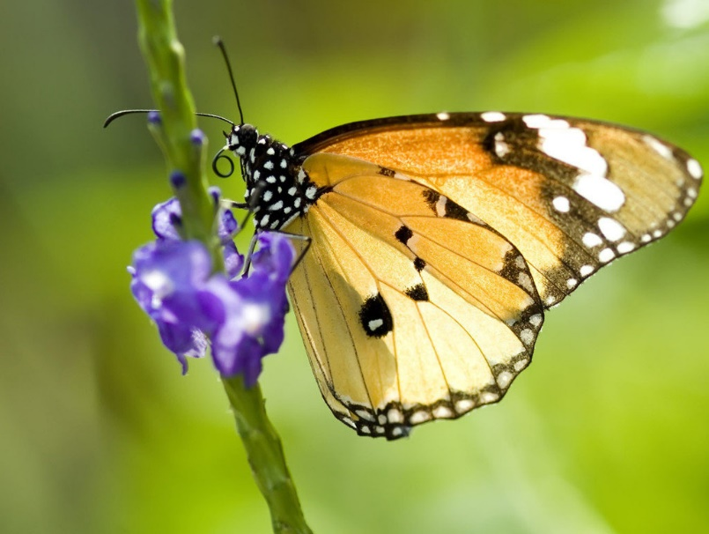

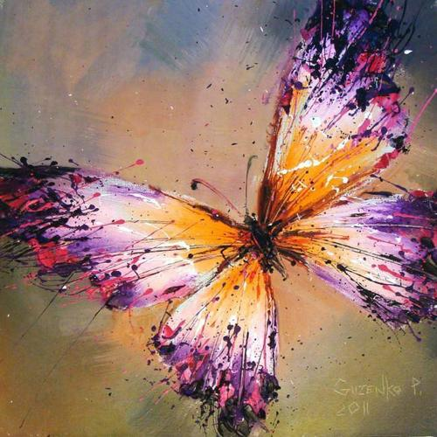
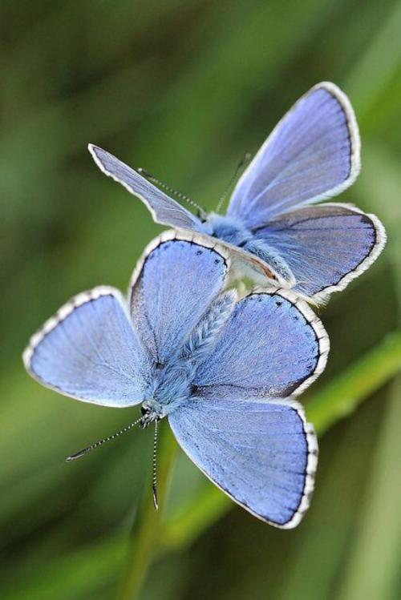
butterfly
beautiful

Slide 6

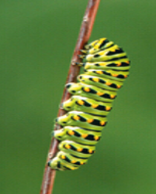

about 15 days
4.27
5.14
then
now
It was ________then.
It is ________now.
beautiful

Slide 7
Look and say

Slide 8

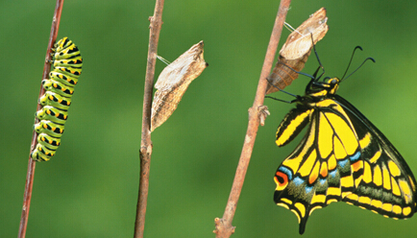
about 15 days
4.23
…
…
5.6
5.7
5.12
then
now
It ____ ________then.
was
beautiful
It ____ ________now.
is
beautiful

Slide 9
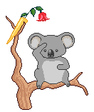

Module 9 Unit 1
They were very young.
changing
变化

Slide 10
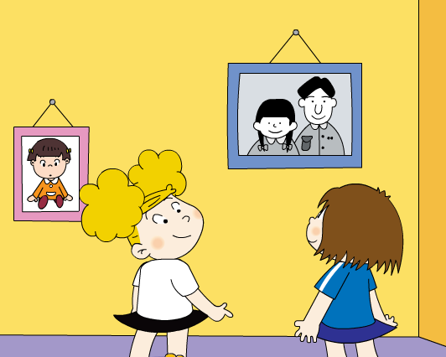
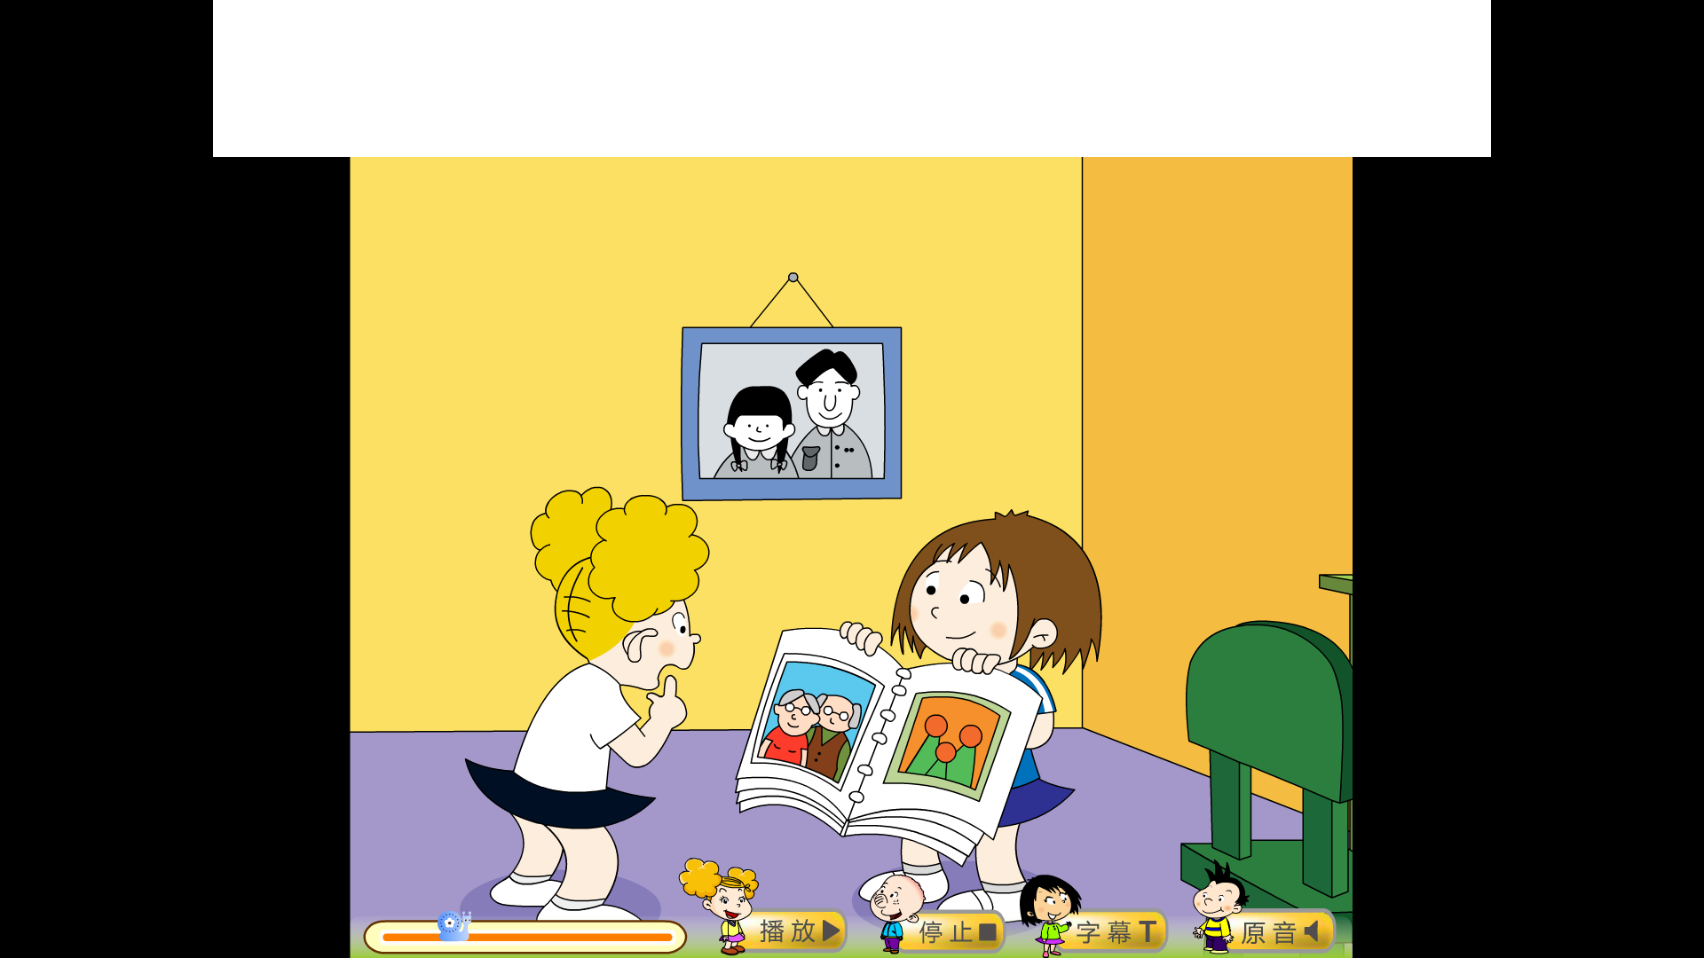
where
what
Lingling’s home
Lingling’s photos

Slide 11
Who are they?
grandparents

Slide 12
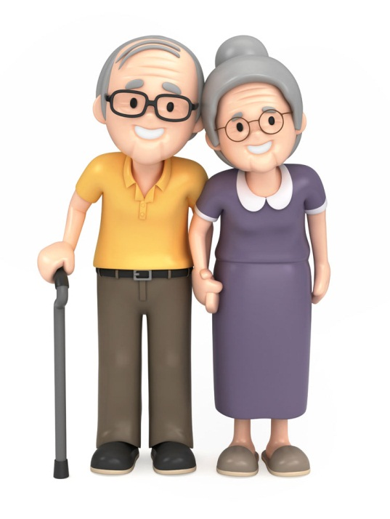
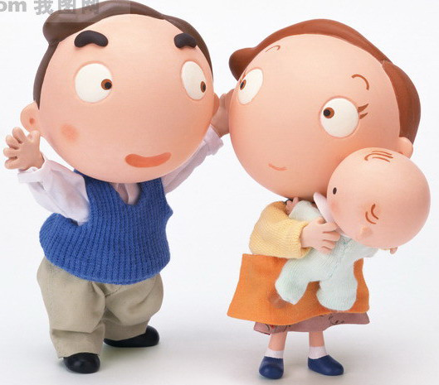
parents
grandparents
father
mother
grandpa
grandma

Slide 13

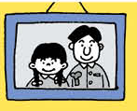

Who are they, Lingling?
They are my ____________.
grandparents

Slide 14
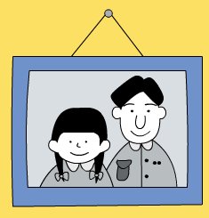

about 30 years
1989
2019
then
now
They ____ _____then.
They ____ ___now.
were
are

Slide 15
Listen and look. Then find the details.

Slide 16
about 30 years
1987
2017
then
now
They ____ _____then.
They ____ ___now.
were
young
are
old

Slide 17
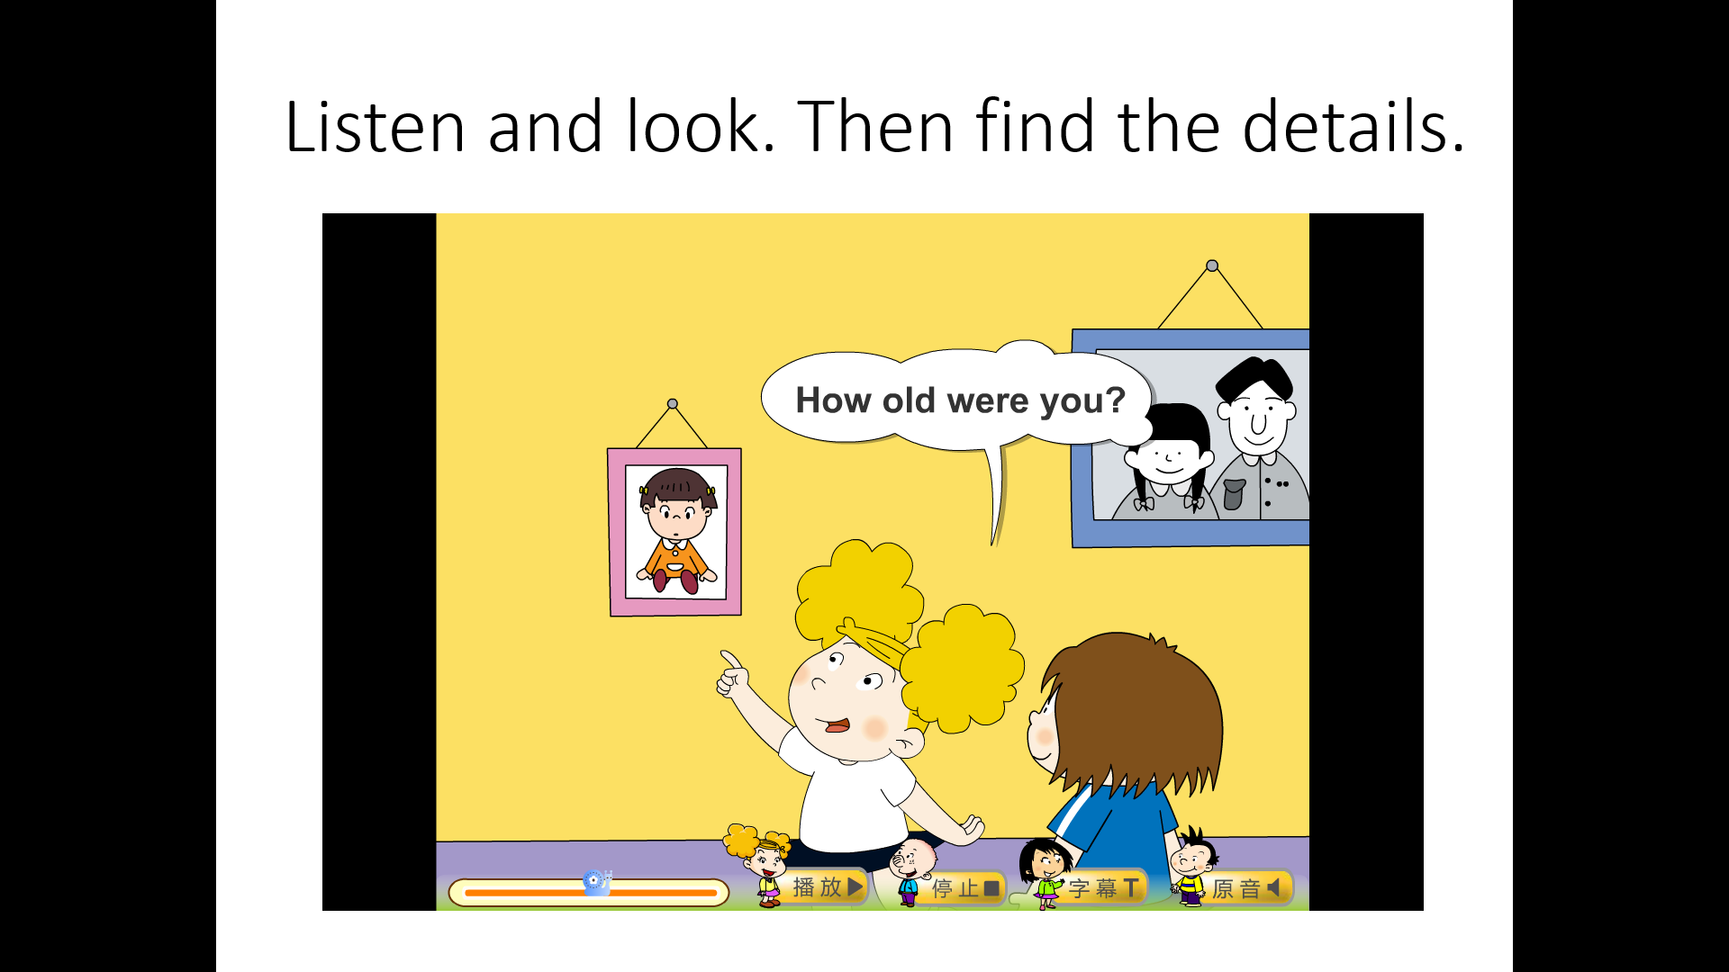

How old were you?
I was two.

Slide 18

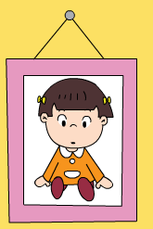
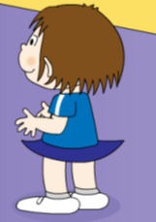
8 years
2011
…
…
2019
then
now
She was two then.
She is ten now.
She ____ little then.
She ___ big now.
was
is
She ____ _____ then.
She ___ ____ now.
was
short
is
tall

Slide 19

7 years
2011
…
…
2019
then
now
Her hair ____ _____ then.
was
short
Her hair ___ ____now.
is
long

Slide 20
You were very cute.
I was very naughty,too.

Slide 21

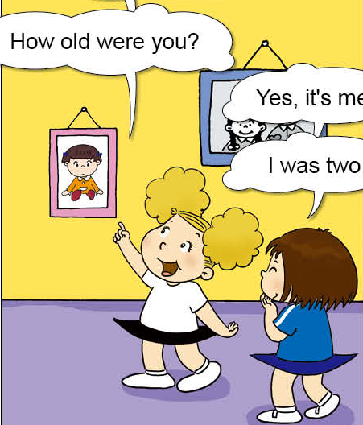
then
now
was
1. I ____ two .
2. Your hair ____ very
short then.
3. You very ____ cute.
4. I _____ naughty.
1. I am ten .
2. Your hair is long .
3. You are very clever.
4. I am quiet .
was
were
was

Slide 22
Listen and repeat.

Slide 23
then: 那时候，表示发生在过去的事情。
过去then： 现在now:
am
is
are
was
were

Slide 24

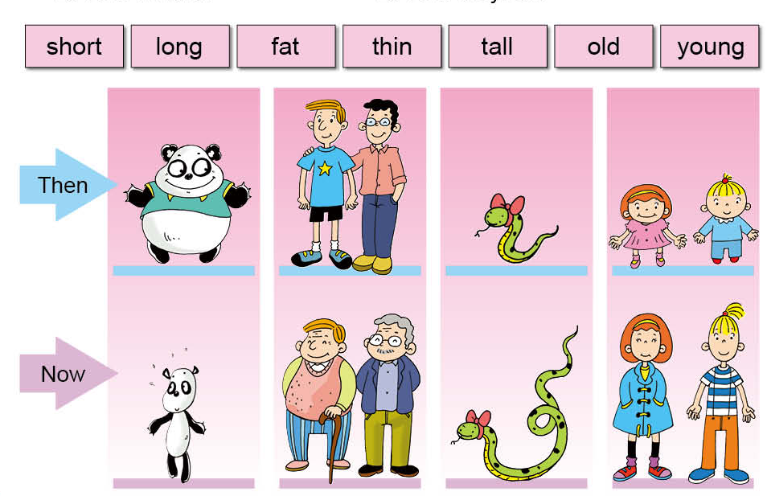

Slide 25
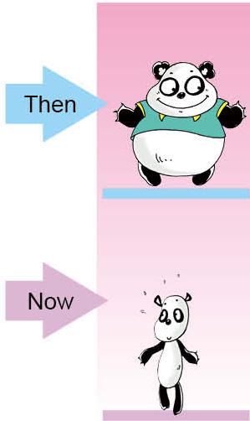
It was ____then.
fat
Now it’s ____.
thin

Slide 26
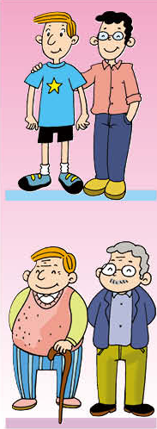


They were______then.
young
Now they are____.
old

Slide 27
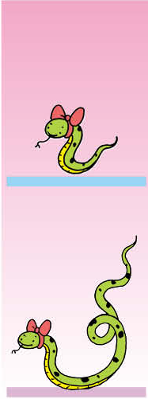
It ____ ______then.
was
short
Now it’s ______.
long

Slide 28
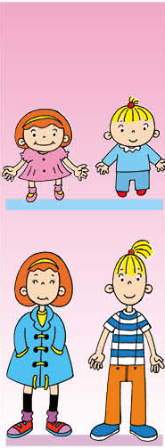
They _____ _____then.
were
short
Now they ___ ____.
are
tall

