Slide 1
Module 9
Unit2 He was in Hong Kong.
新标准英语
一年级起点三年级下册

Slide 2
I was fat.

Slide 3
Let’s talk about our holiday----May Day（5.1）
I was at home.
I wasn’t in Deyang.
was not.

Slide 4
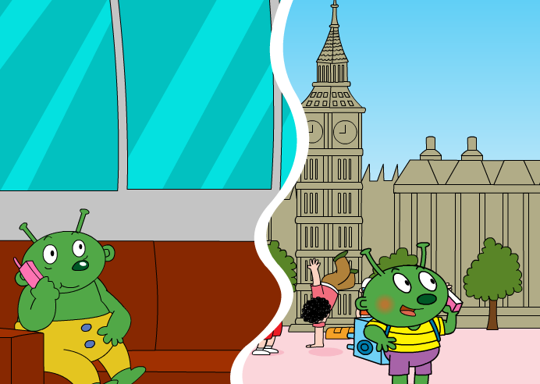
Bobo is on holiday now.

Slide 5
Where is Bobo now? What’s he doing?
Where was Bobo yesterday?

Slide 6
Where was Bobo yesterday?

Slide 7
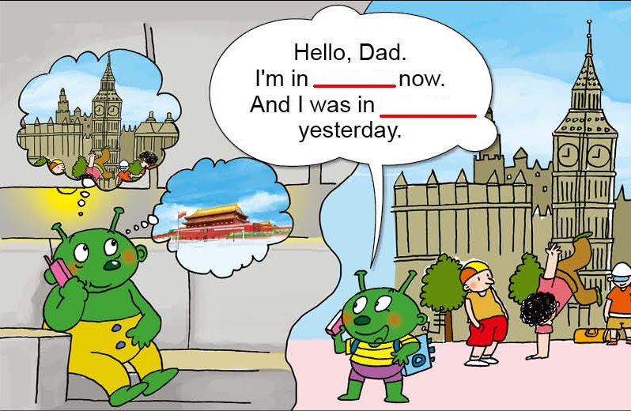

Slide 8
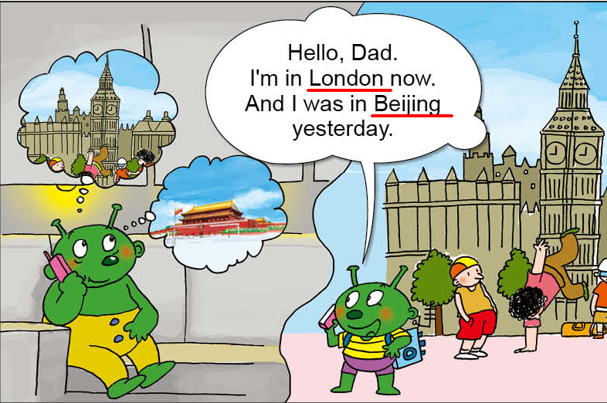

Slide 9
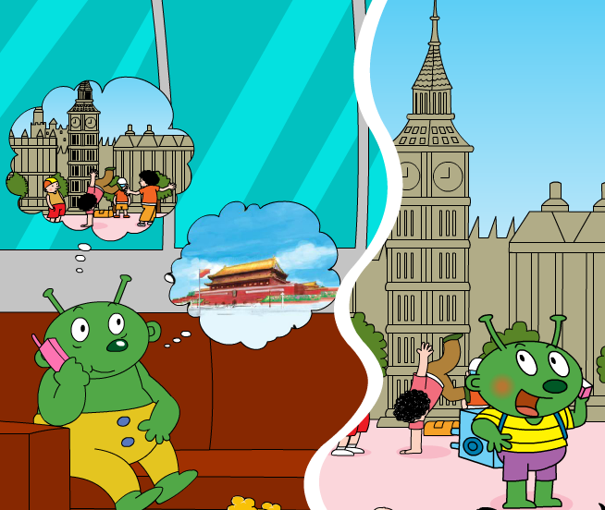
Bobo _______in
Yes!
Bobo _____ in Beijing yesterday.
was
No!
wasn’t
Bobo ______ in London yesterday.

Slide 10
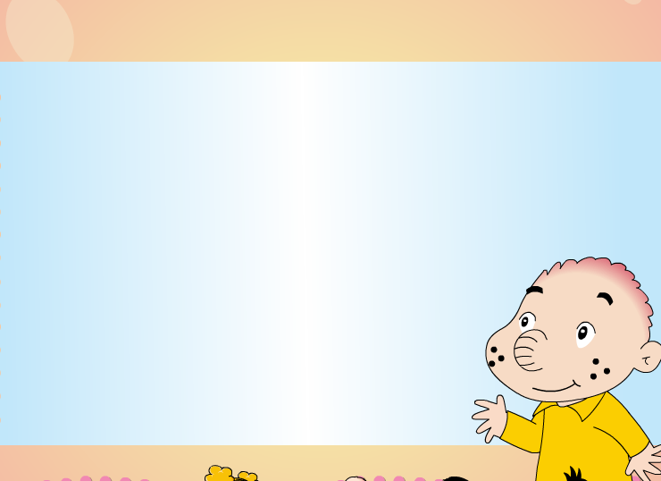
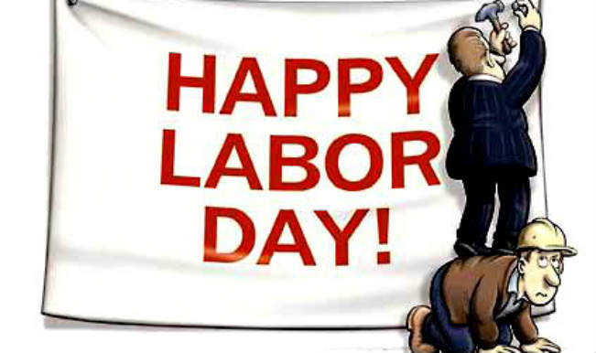
Sam’s family was on holiday, too.
Where were they?

Slide 11
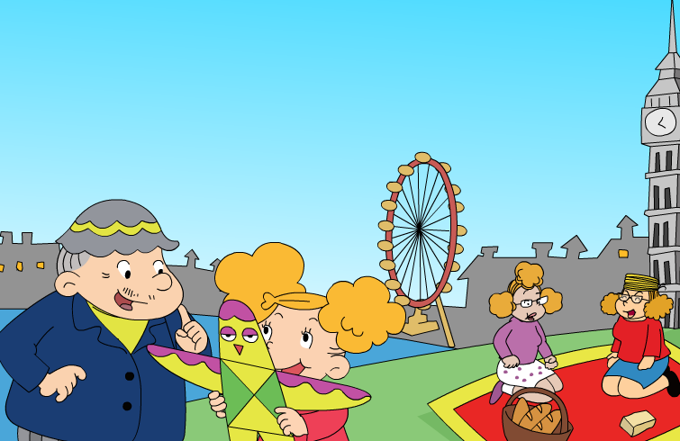
My mum and Amy were in____.

Slide 12
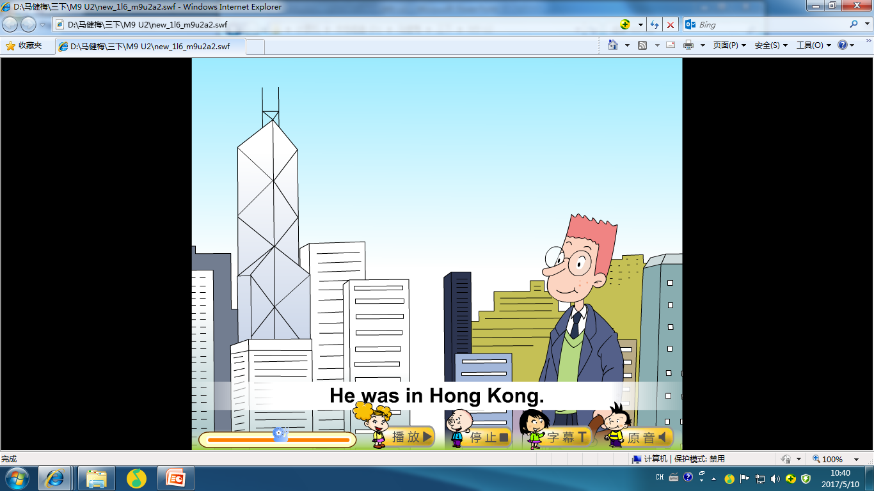
My dad was in____.

Slide 13
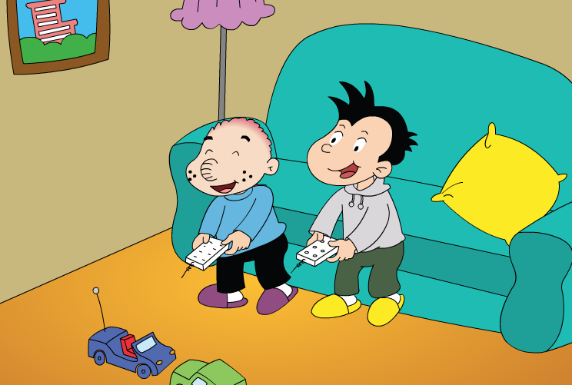
I was in____.

Slide 14
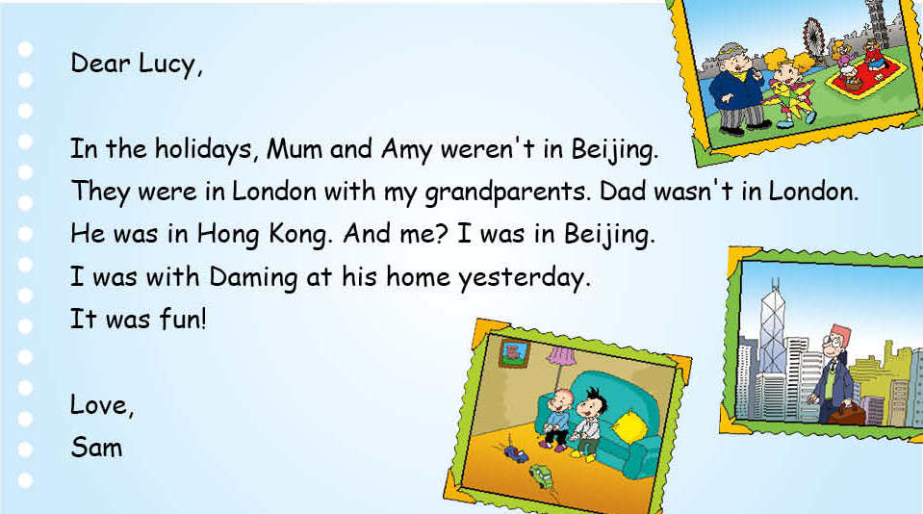
Read and underline.
1
2
3

Slide 15
Read and underline.
1. Where were Mum and Amy?
They were in London with my
grandparents.
2. Where was Dad?
He was in Hongkong.
3. Where was Sam?
He was in Beijing.

Slide 16
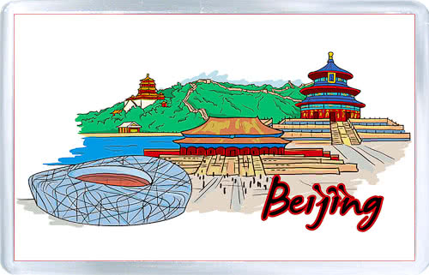
√
×
Yes!
were
Mum and Amy _____ in London.
No!
weren’t
Mum and Amy ______ in Beijing.

Slide 17

√
×
was
wasn’t
Dad _____in Hong Kong.
Dad ______ in London.
Yes!
No!

Slide 18
√
×
wasn’t
was
I ______ in London.
I _____in Beijing.
Yes!
No!

Slide 19
wasn’t
were
was
weren’t
1. Mum and Amy ______ in Beijing.
They ______ in London.
2. Dad ______ in London.
He _____ in Hong Kong.

Slide 20
Listen and read. Then retell.

Slide 21
Dear Lucy,
In the holidays, Mum and Amy ______ in
______. They ______ in London with my
_________. Dad _______ in London. He
_____ in ________. And me? I _____ in
______. I _____ with Daming at his _____
yesterday.
It _____ fun!
Love,
Sam
weren’t
Beijing
were
grandparents
wasn’t
was
Hongkong
was
Beijing
was
home
was

Slide 22
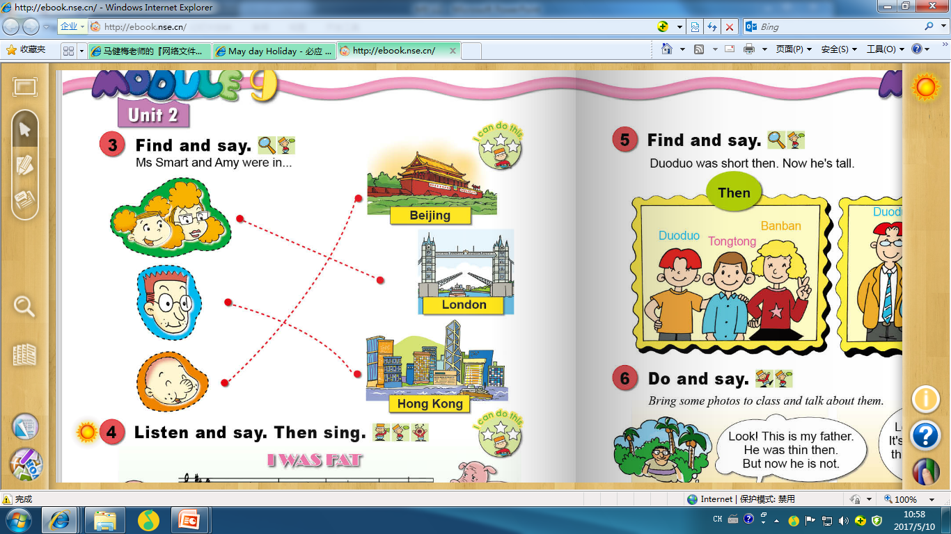

Slide 23
Yes!
were
Mum and Amy _____ in London.
No!
weren’t
Mum and Amy ______ in Beijing.

Slide 24
was
wasn’t
Dad _____in Hong Kong.
Dad ______ in London.
Yes!
No!

Slide 25
was
wasn’t
Sam _____in Beijing.
Sam ______ in London.
Yes!
No!

Slide 26
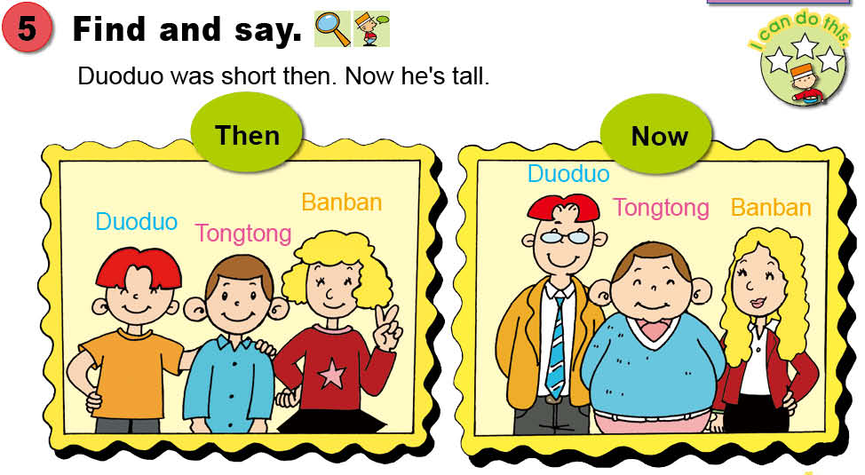
_____ was ___ then.
Now _____ is _____

Slide 27
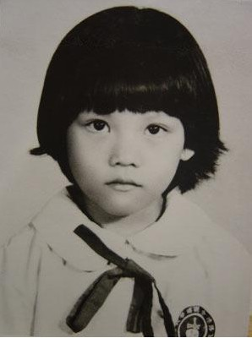
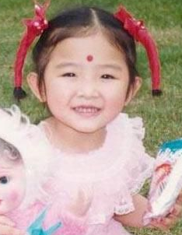
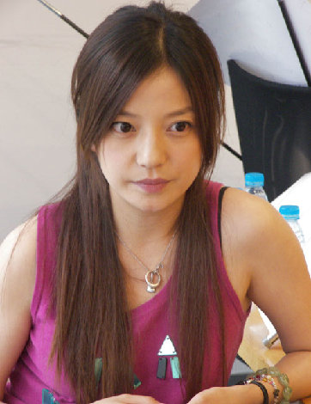
Guess
then
now
A
B
She was 6 then.
Her hair was short.
Her eyes were big then.
She is 40 now.
Her hair is long.
Her eyes are big.

Slide 28
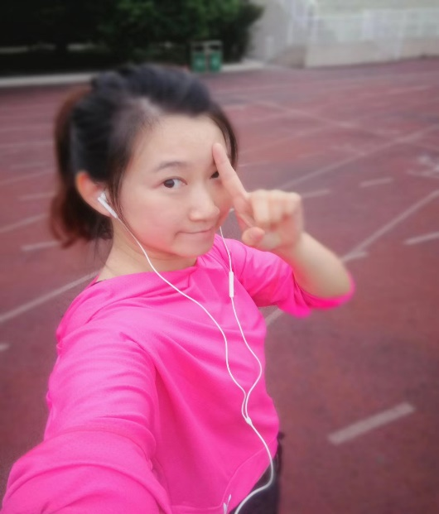
Guess
then
now
?
was
She ___ a little girl then.
She ____ one then.
Her hair ____ short.
She is a teacher now.
She is 28 now.
Her hair is long.
was
was

Slide 29

then
now
Look at this little _____. It’s me.
I ____(was/am)___now.
I ____(was/am) _____then.
___(He/She) ___(was/is) ____then.
And this is my ___.
But now___(he/she) ___(was/is) ___. I still love__(him/her).

