Slide 1
Module 4 Unit 2
He doesn’t like these trousers .

Slide 2
Let’s chant.

Slide 3
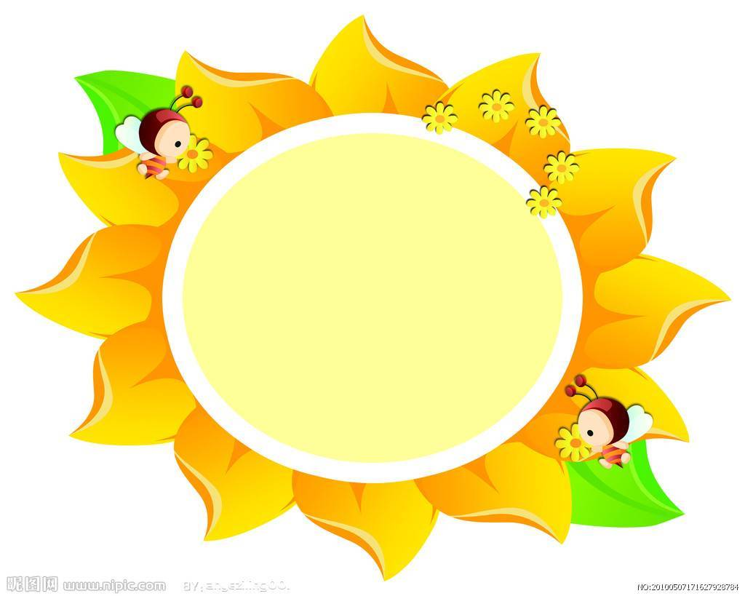
Magic Eyes

Slide 4
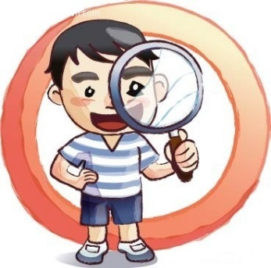
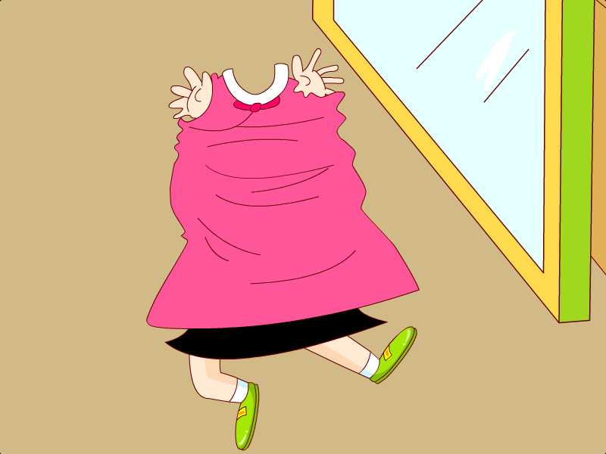
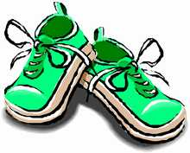
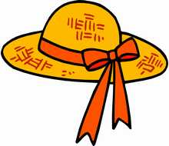
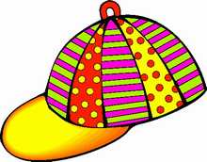
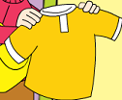
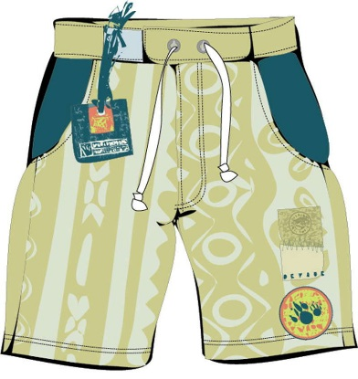
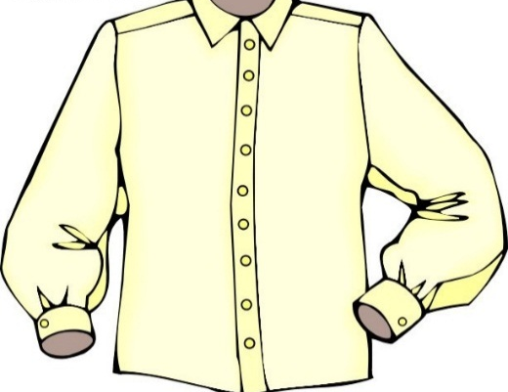
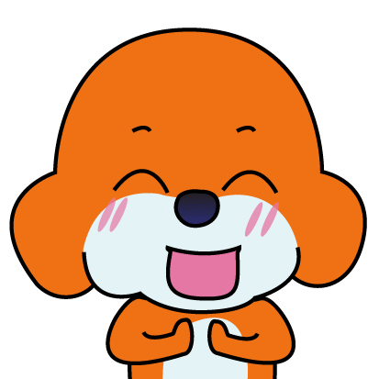
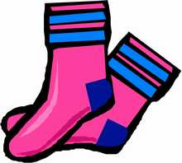

Slide 5
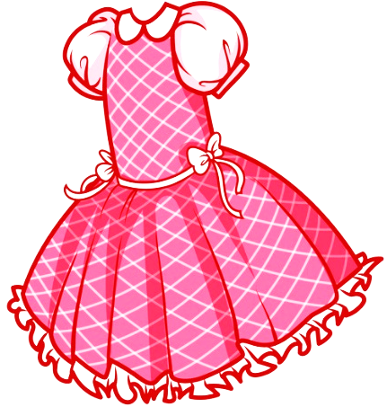
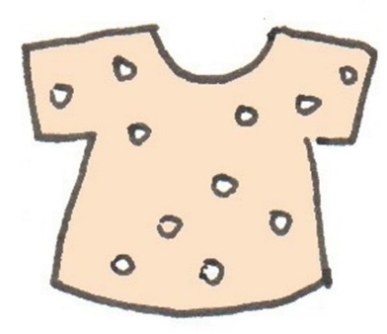

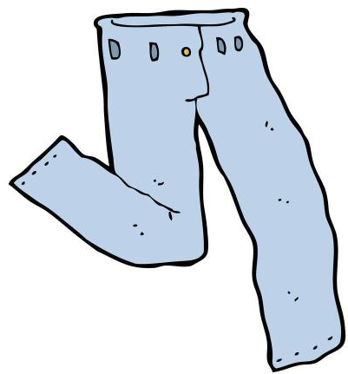
What clothes do you like?
I like……

Slide 6




Do you like T-shirts?
Yes, I do.
No, I don't.

Slide 7
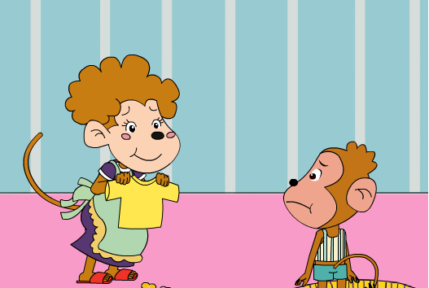
？
？
He doesn't like the yellow T-shirt.

Slide 8
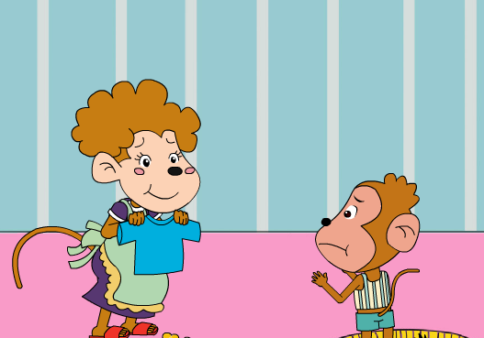
？
？
He doesn't like the blue T-shirt.

Slide 9
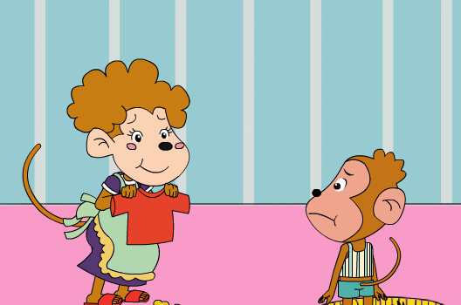
？
？
He doesn't like the red T-shirt.

Slide 10
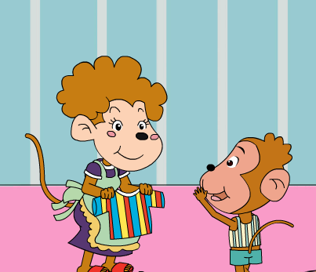
？
？
He likes the yellow, blue
and red T-shirt.

Slide 11
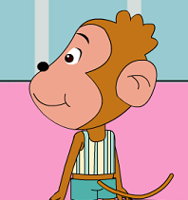
He doesn't like ________________.
He likes _________.

Slide 13

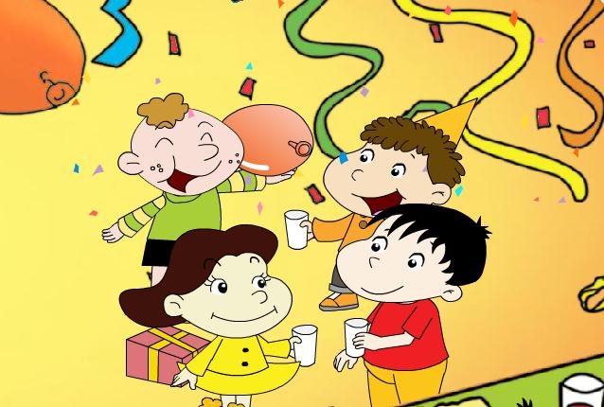
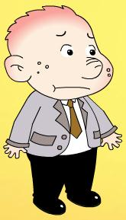

Where’ s Sam?
Sam’s at a party.

Slide 14


Dose he like the party?
Yes, he does.
No, he doesn’t.
He doesn’t like it.
Why

Slide 15
Watch and answer.

Slide 16
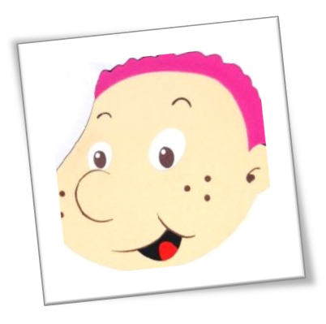



Because(因为) ......
He doesn’t like these clothes.
these trousers.
this shirt.
these shoes.

Slide 17
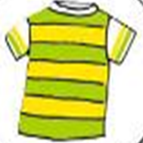
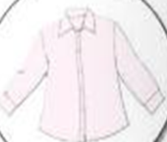
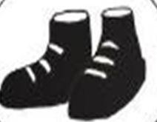
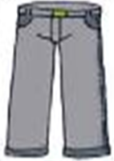
this T-shirt
this(这个)
单数
this shirt
these shoes
these（这些）
复数
these trousers

Slide 18
Listen and repeat.

Slide 19
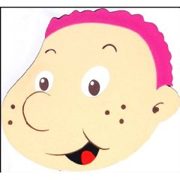

Point and say.
He likes this________.
He likes these________.
He doesn’t like this________.
He doesn’t like these________.

Slide 20
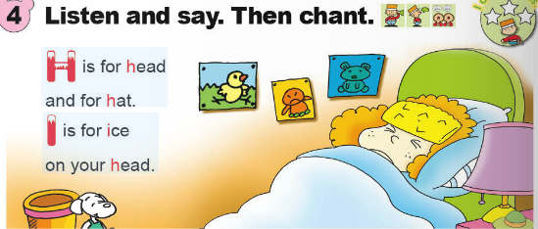


Slide 21
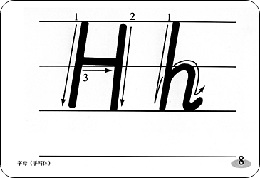

Slide 22
