Slide 1
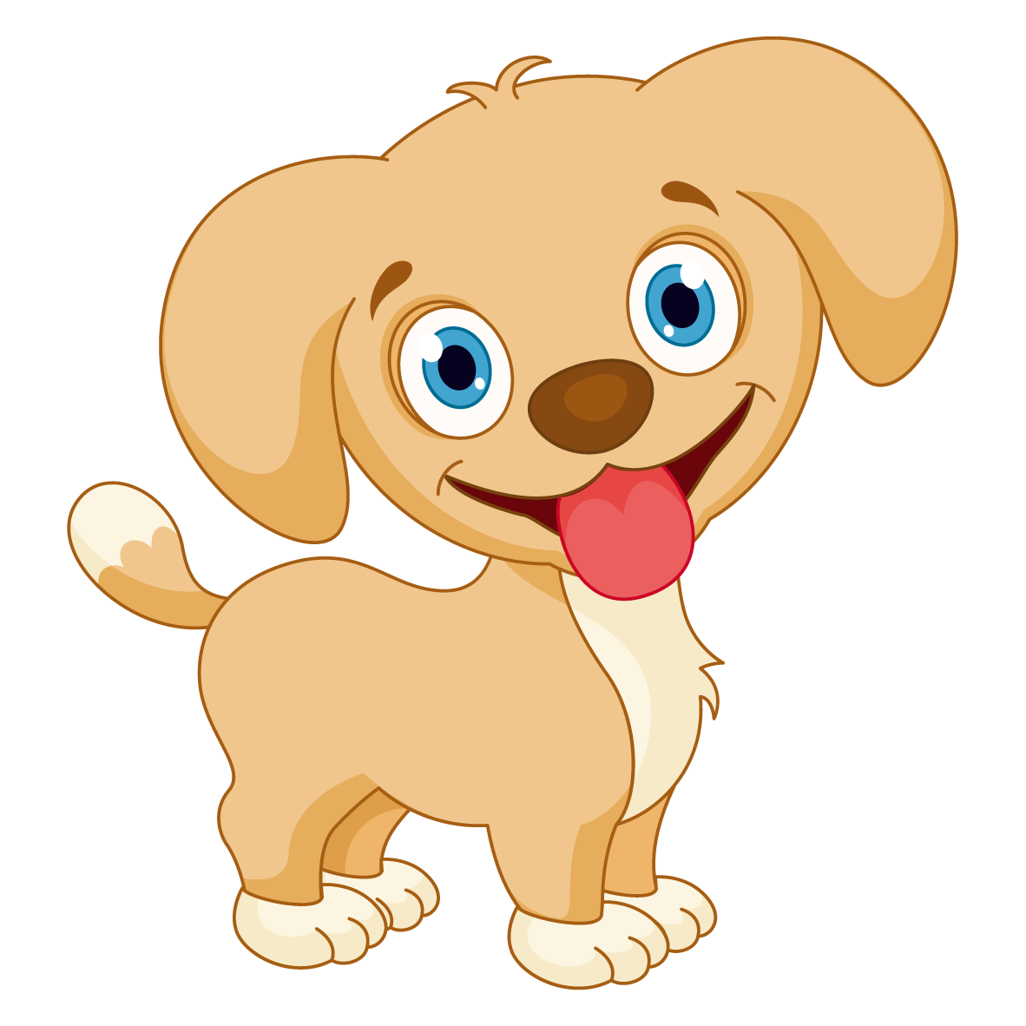

Slide 2
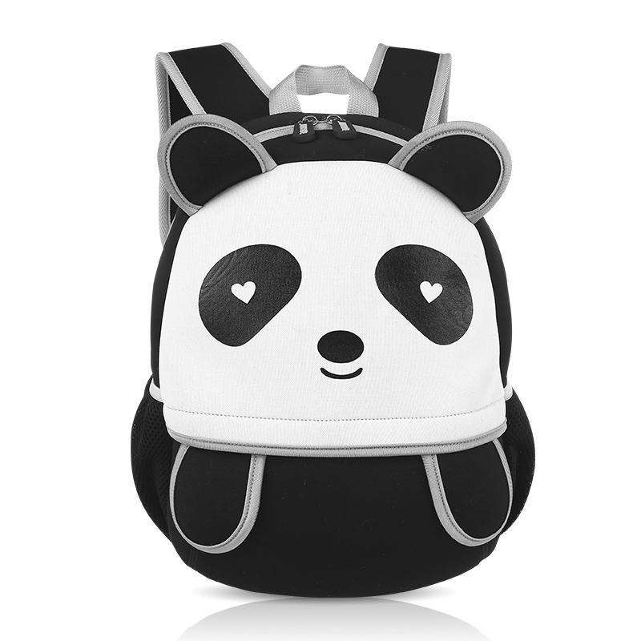
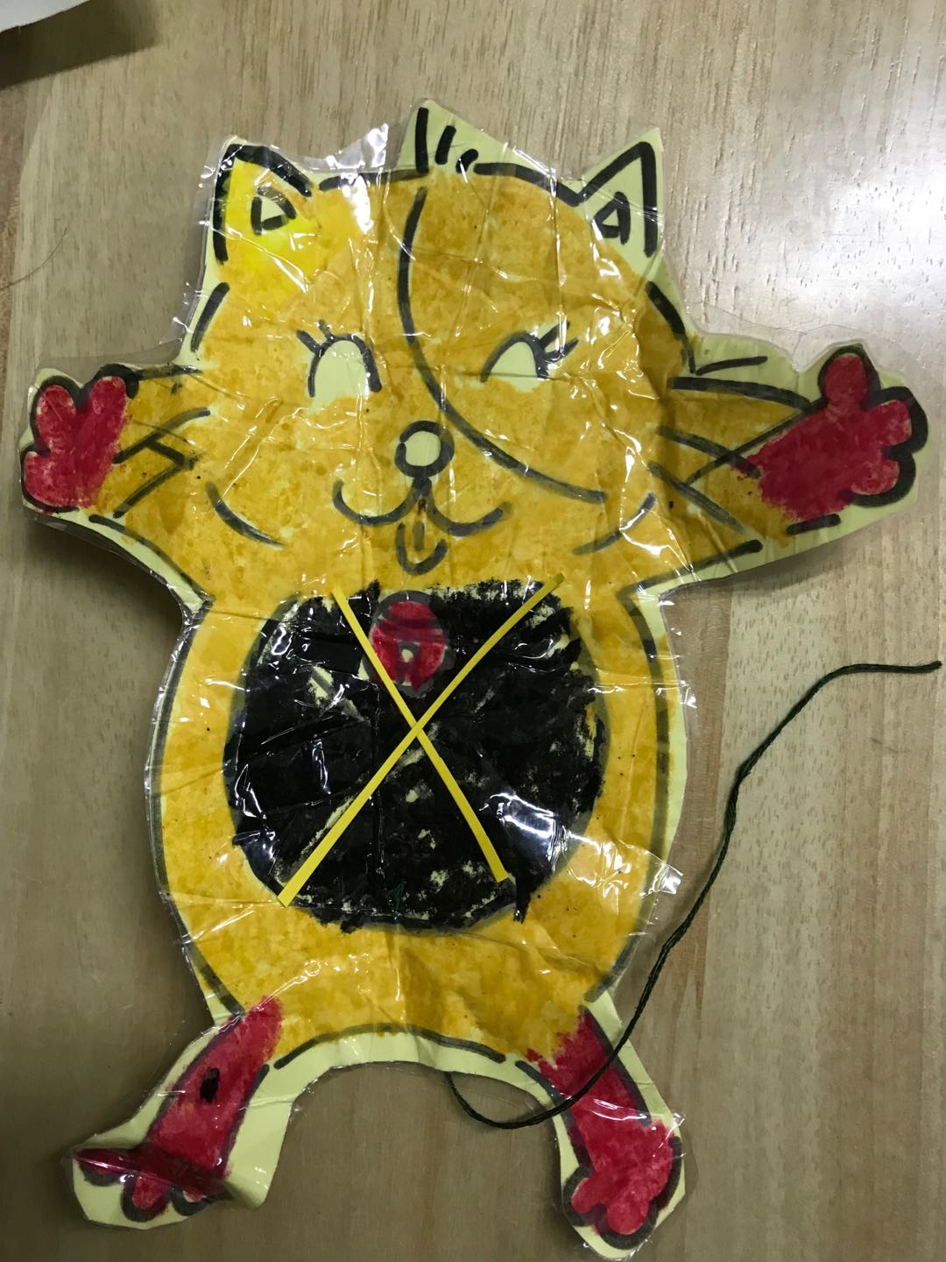
panda
It’s a ________ _________.
monkey
schoolbag
cat
kite
ruler

Slide 3
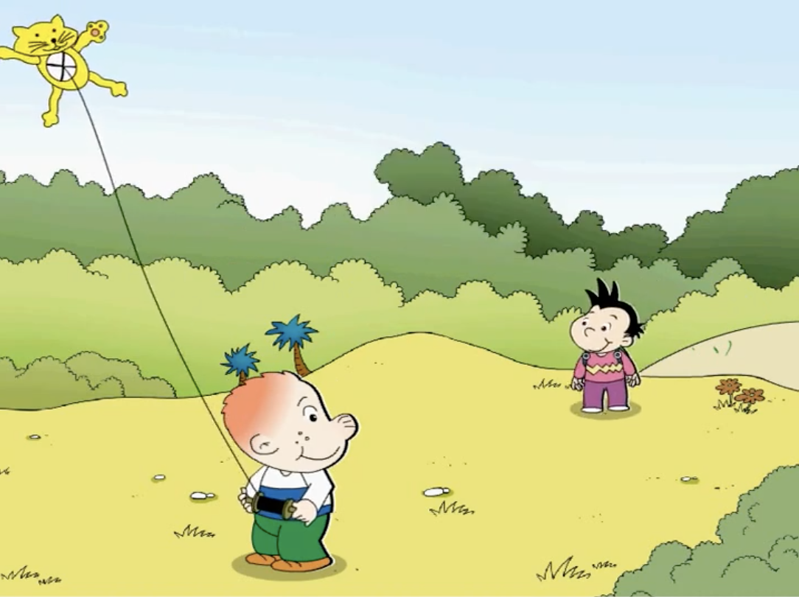
Notes:
Sam is flying his new kite. Daming is coming. What will Sam say? 抽问两三个同学
Now, let’s watch a video and find it out.

Slide 5
Notes:
Look at Sam. Is Sam happy? No, sam is very scared. What will he say?
Listen. What does Sam say?

Slide 10
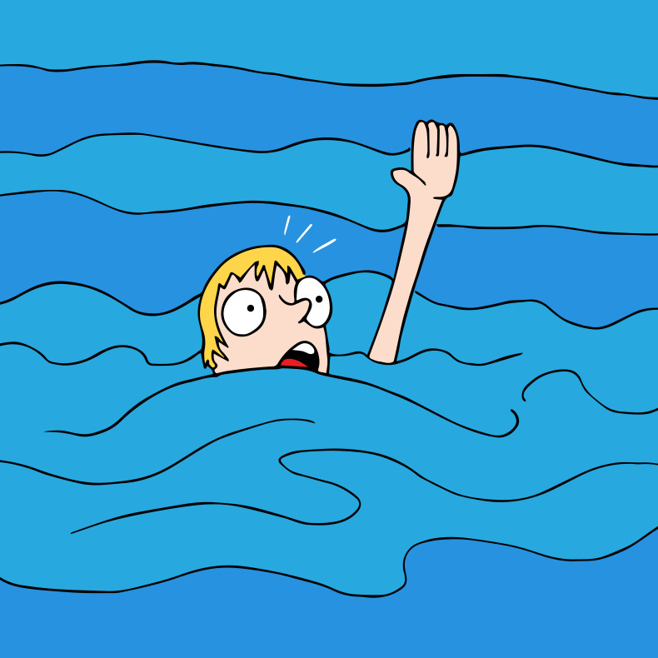
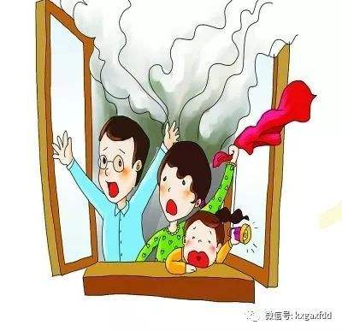
Help!!
Help!!

Slide 13
Listen, point and find “Is it a …?”

Slide 14
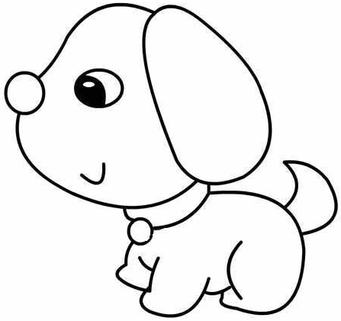
Homework
Listen, point and read the text.
听并指读课文（38-39页）
Draw an animal and your partner will guess by asking “Is it a …?”
画一个你喜欢的动物，让你的同伴来猜

